Slide 1
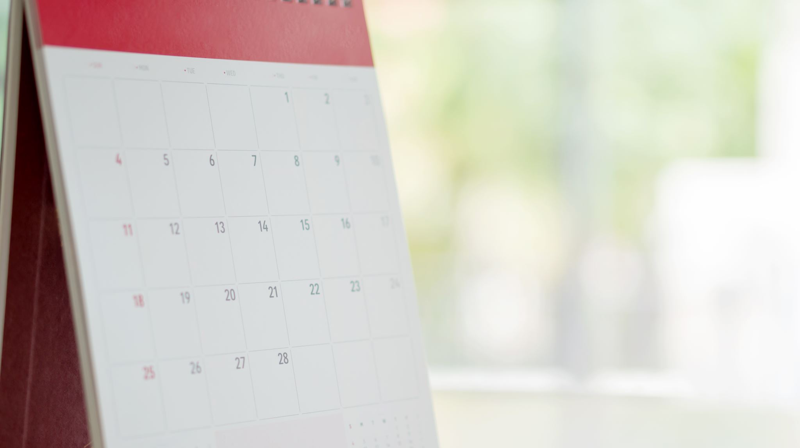
PAST SIMPLE

Slide 2
Use of PAST SIMPLE
Actions started and finished in the past.
In 2003 she married Peter.
Repeated actions in the past.
We played basket every Friday last year.
Actions lasted for a certain period in the past.
I worked in a library for 6 months in 2001.
Stories and descriptions of past events.
One day the Princess decided that she wanted to leave the castle...

Slide 3
TO BE & TO HAVE
To be
To have
I/he/she/it WAS (NOT)
WAS I/he/she/it ...?
Yes, I/he/she/it WAS / No, I/he/she/it WAS NOT (WASN’T)
You/we/you/they WERE (NOT)
WERE You/we/you/they ...?
Yes, you/we/you/they WERE /No, you/we/you/they WERE NOT (WEREN’T)
All subjects ->HAD
I DID NOT (DIDN’T) have time.
DID you have time?
Yes, I DID / No, I DIDN’T.
What DID you have?

Slide 4
REGULAR VERBS +ed
Wash _ washed
Drop _ dropped
Deter _ deterred
Save _ saved
Sway _ swayed
Cry _ cried
Repel _ repelled
Boil _ boiled

Slide 5
IRREGULAR VERBS
Say – said – said
Drink – drank - drunk
Spend – spent - spent
Cut – cut - cut
Leave – left - left
Speak – spoke – spoken
Hit – hit - hit
Keep – kept - kept
Sing – sang - sung
Wake – woke - woken
Send – sent - sent
Pay - paid - paid

Slide 6
NEGATIVE FORM
Present simple
(Auxiliary do/DOES)
Past simple
(auxiliary did)
I like chocolate.
I don't like chocolate.
She/he likes chocolate.
She/he does not like chocolate.
I liked chocolate.
I didn’t like chocolate.

Slide 7
INTERROGATIVE FORM
Present simple
(Auxiliary do/DOES)
Past simple
(auxiliary )
I like chocolate.
Yes/No Question:Do you like chocolate?
Short answers: Yes, I do/No, I don’t.
Wh Question: What do you like?
I liked chocolate.
Yes/No Question: Did you like chocolate?
Short answers: Yes, I did/No, I didn’t.
Wh Question: What did you like?

Slide 8
Time Expressions
5 years ago
Last summer
In 1987
When I was young
During WWII

Slide 9
PAST HABITS
USED TO + infinitive
WOULD
Luke used to live in a flat. (action)
Luke used to be very fit. (state)
Luke didn’t USE to have a car.
Did Luke USE to drink wine?
Yes, he did / No, he didn’t.
What did Luke USE to read when he was a child?
Luke would live in a flat. (ONLY action, NO state)

Slide 10
PAST HABITS vs PRESENT HABITS
USED TO + INFINITIVE
TO BE USED TO + ING
When I was a student, I used to work as baby-sitter.
Sam is used to cooking dinner for a lot of people for Christmas.

